Slide 1
The Battle of Neighborhoods Toronto
Picking up a location for opening a new restaurant

Slide 2
The Goal
The entrepreneur is planning to open a new restaurant in Toronto, but he is not sure which location would be most appropriate for his new venue. We noticed that the Toronto already has a lot of restaurants in town, but we need to give an advise on best possible location.

Slide 3
The Data
We can identify the most important factors that contribute to the restaurant’s success to be among the following list: neighborhood wealth, accessibility, crime rates, visibility, competition, etc.
We should use the datasets from Toronto Opendata website to address some of these considerations.
Due to the scope of this project we would limit our data to the city’s average housing prices list, which we could get from “Get Wellbeing Toronto - Economics data set”.
Also we will use the Foursquare location data to retrieve the food venues. This location data in conjunction with the average house price by Neighborhood should help us to determine the best possible location for a new restaurant.

Slide 4
The Methodology
We should combine the average house price from “Get Wellbeing Toronto – Economics” data set with the Neighborhood postal code dataset to get house prices per postal codes.
We should get the venues from food category using the “Foursquare” location data. We would cluster the combined data and would try to determine the best possible location for the new restaurant.

Slide 5

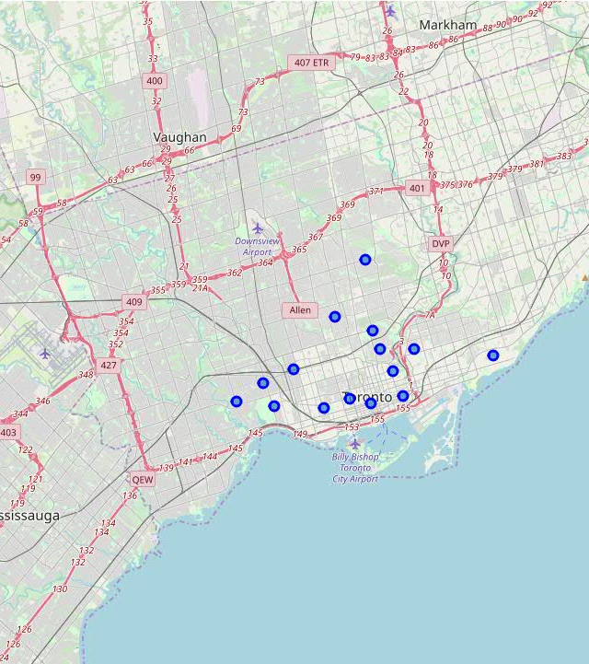
Neighborhoods
When we grouped the average house price data with the Neighborhood postal code dataset we were able to get a new dataset for house prices per postal codes.
This provided us with 14 Toronto postal codes areas.

Slide 6
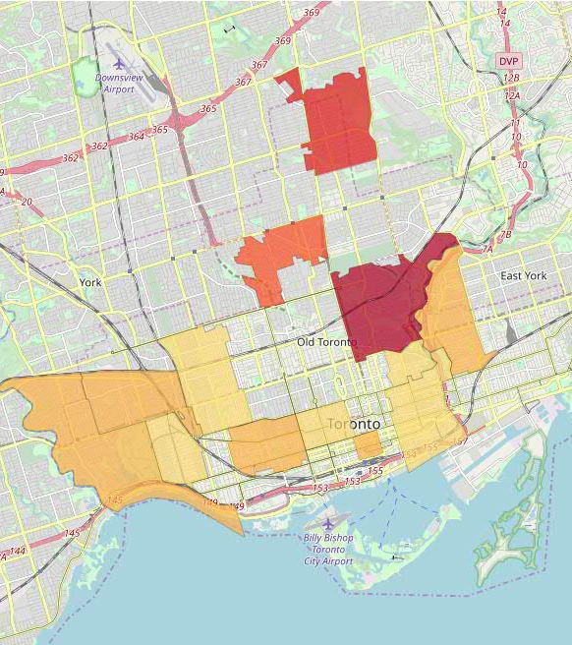
House Prices
Unfortunately we were unable to get the average price data for all Toronto neighborhoods, but we still can identify areas that could interest our client.
We see three areas where the average house price is above 1 million - around Rosedale, Summerhill East and Lawrence Park.

Slide 7
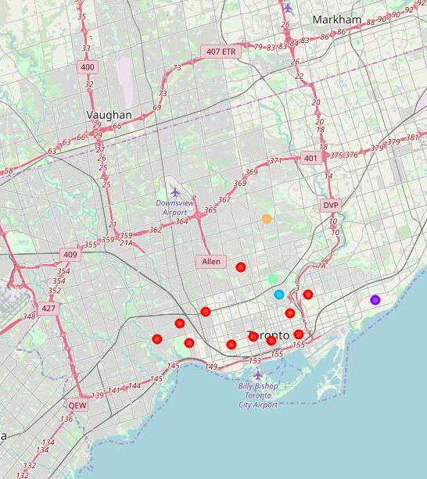
The Clusters
Got nearby venues from Food category for all Toronto neighborhoods, giving us all restaurants in the selected area.
Get 10 most common venues.
Run *k*-means to cluster the neighborhood into 5 clusters.

Slide 8
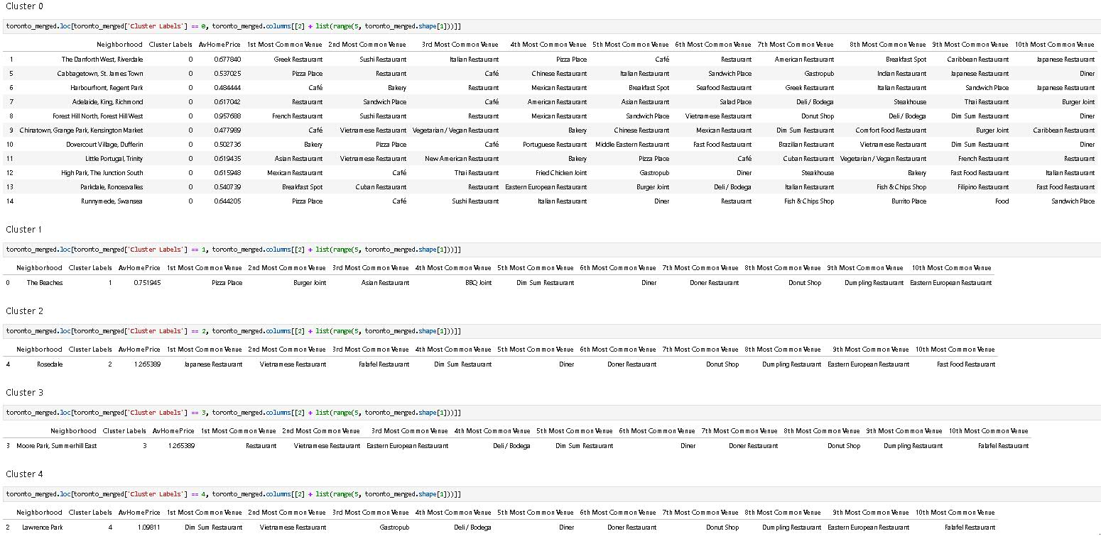
The Results
Most of the neighborhoods are located in the 1st cluster.
In the 1st cluster, the most common venues in the neighborhoods are cafes and pizza places.
Three clusters are around the most expensive neighborhoods.

Slide 9
The Discussion
Where should we open a new restaurant? Housing price maps show that the Lawrence Park cluster (4) neighborhood might be a good candidate. This area looks like a quite densely populated area, so we expect the region to have a lot of foot and car traffic, so good visibility. This neighborhood has also reasonable average house prices.

Slide 10
The Conclusion
This is only a first-order solution to the question 'Where to open a new restaurant in Toronto?' Using public datasets, we were able to partially address one of the factors that we have mentioned at the beginning - average house prices. There certainly is lot of room for improvement. For example, we have to factor in crime rates, competition etc. Toronto Opendata website should have other datasets that we might use to further improve the results.

